Slide 1

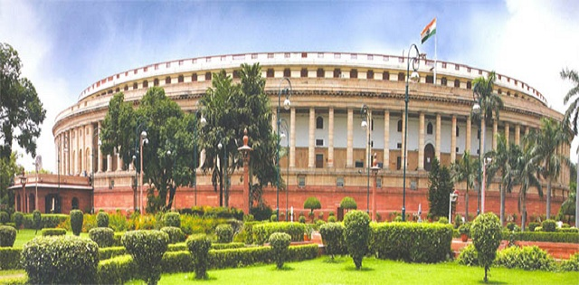
LOK SABHA ELECTIONS

Slide 2

Political Juggernauts: A Quantitative Analysis of Candidates in the 2019 Lok Sabha Elections
SUBMITTEED BY
K.VANITHA (HEAD OF THE PROJECT)
K.HARINI
M.JAYABARATHI
G.THAMIZINI
GUIDED BY
DR. JANSI MAM

Slide 3
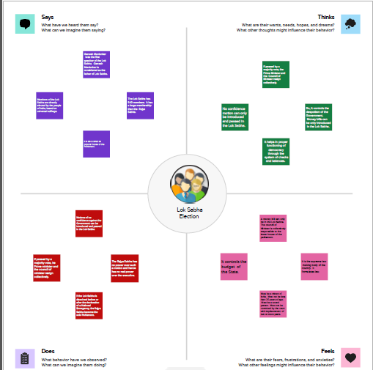

Slide 4
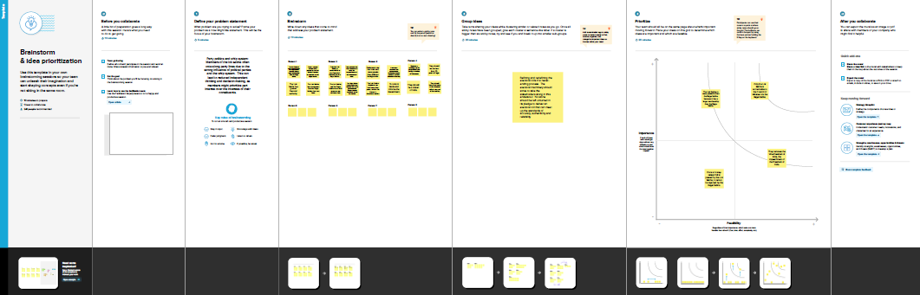

Slide 5
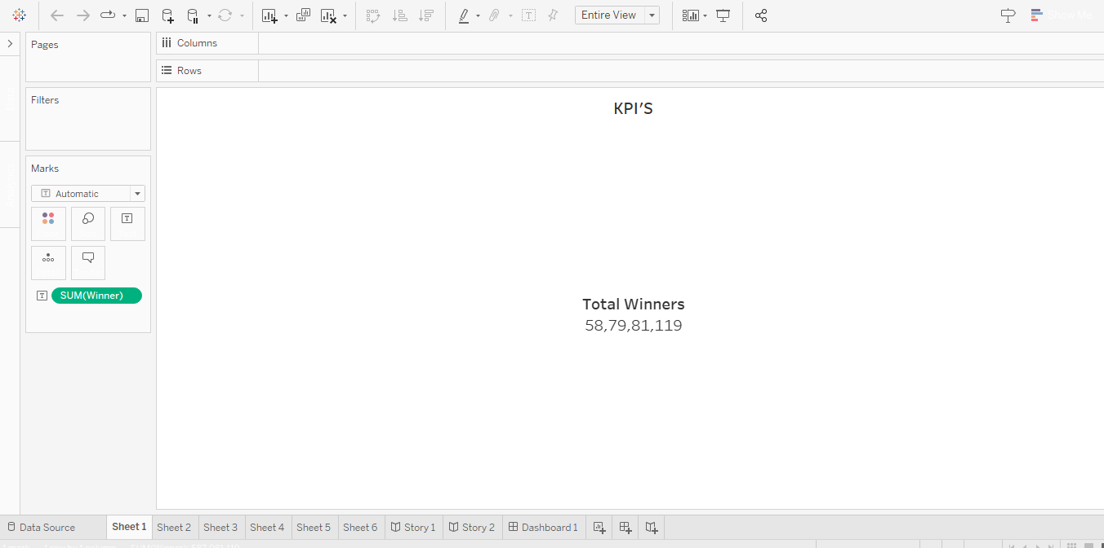
KPI’S

Slide 6
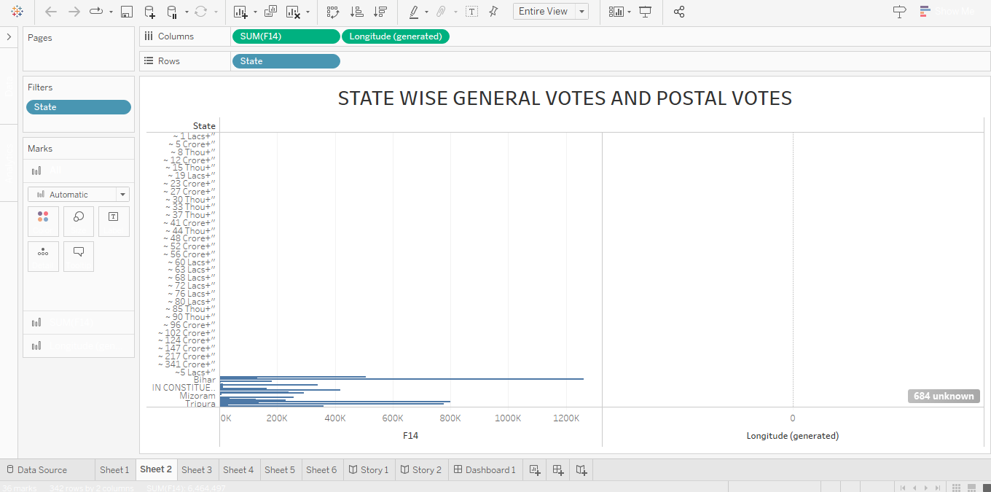
STATE WISE GENERAL VOTES AND POSTAL VOTES

Slide 7
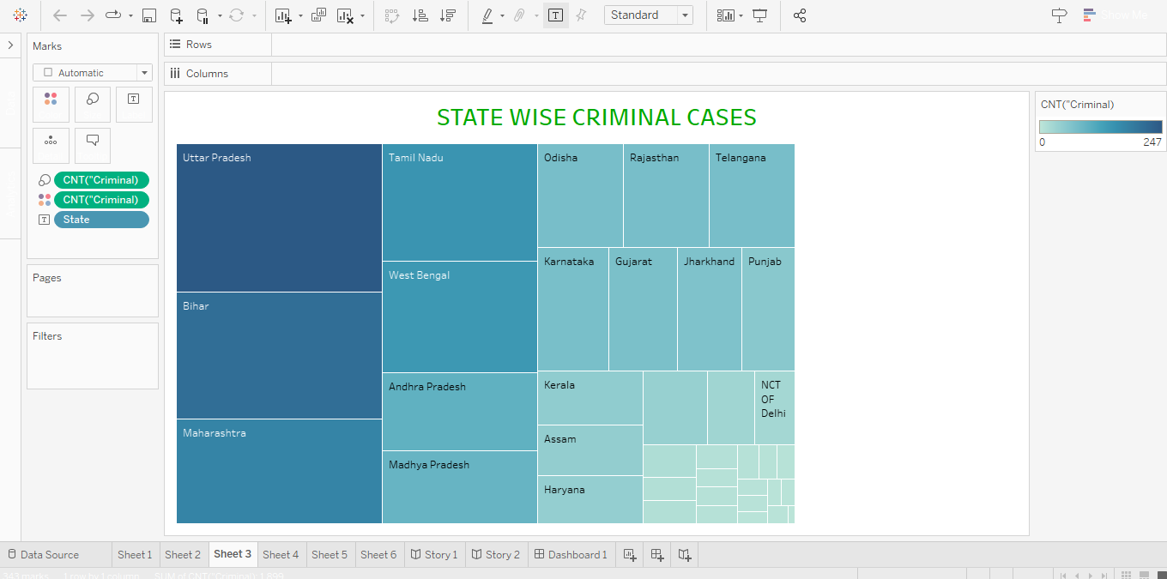
STATE WISE CRIMINAL CASES

Slide 8
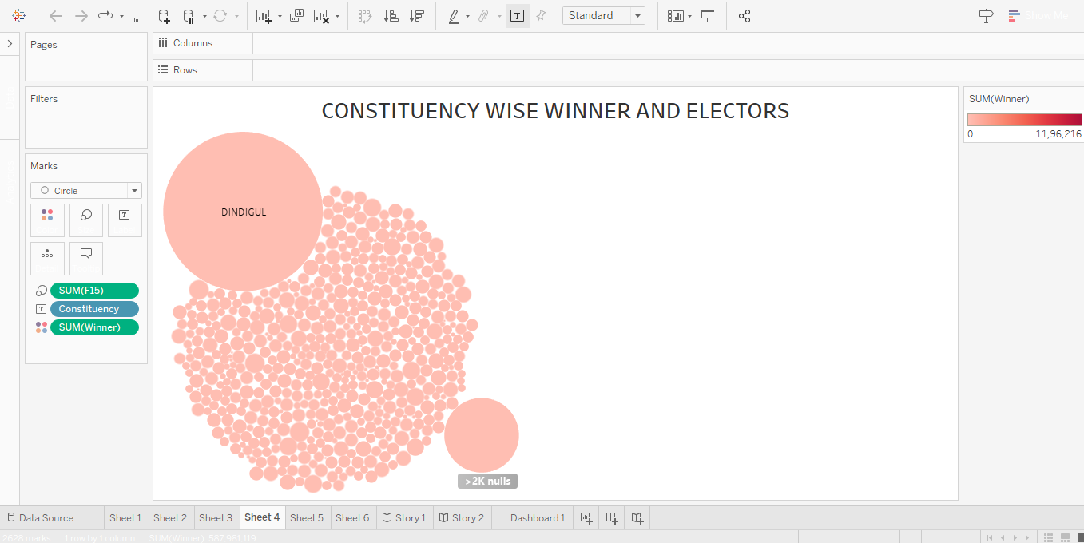
CONSTITUENCY WISE WINNER AND ELECTORS

Slide 9
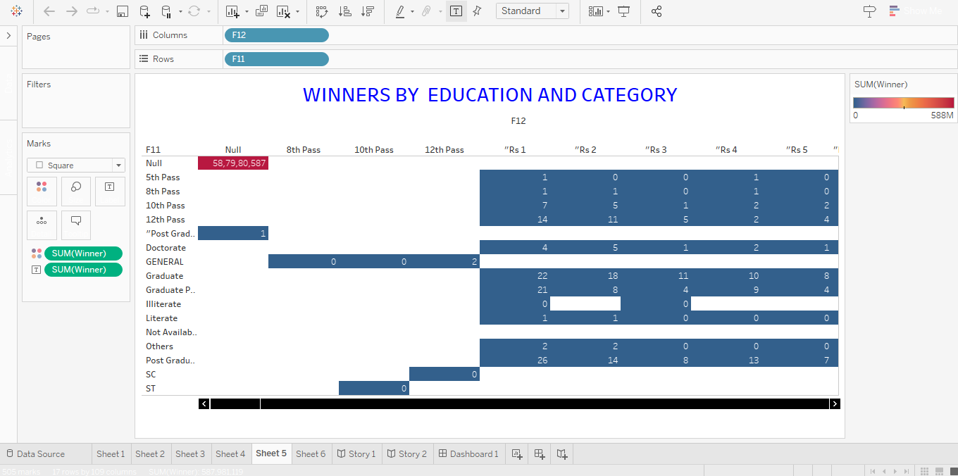
WINNERS BY EDUCATION AND CATEGORY

Slide 10
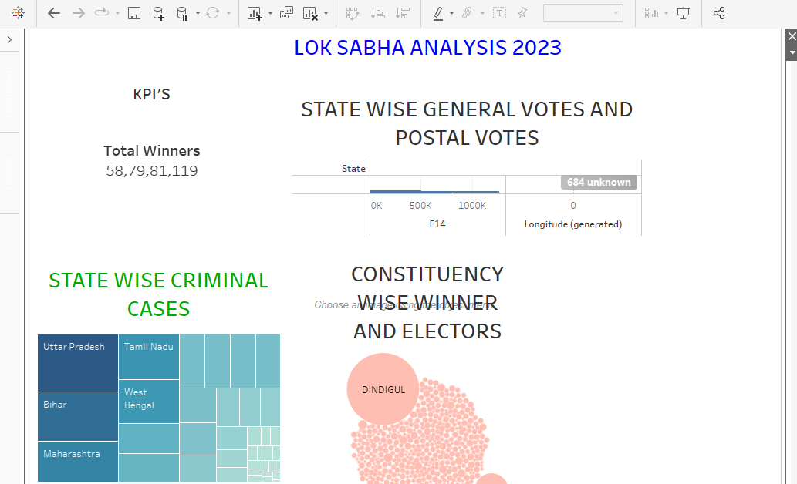

Slide 11
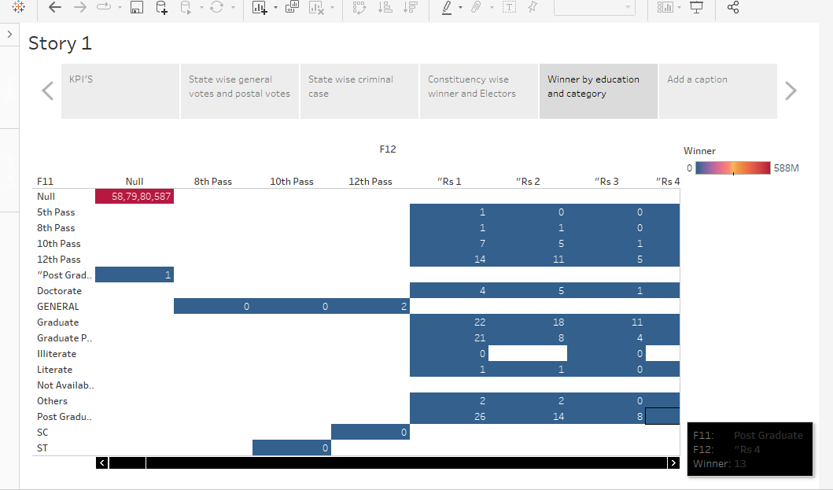

Slide 12
Thank You

